Slide 1
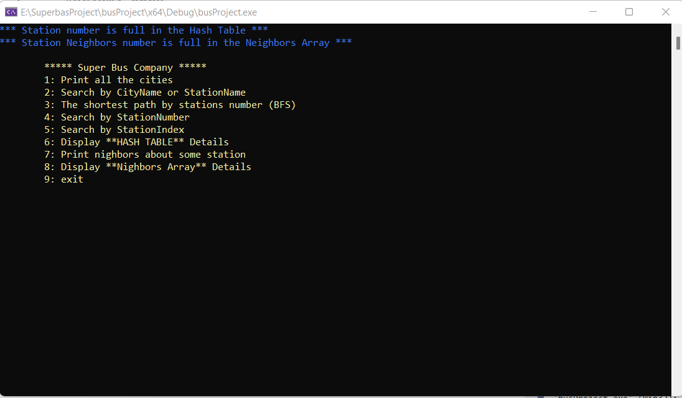

Slide 2
Data (StNum,Line,StName,City,Distance,IndexInNieghborsArry) | Index
………. | 0
……….. | . . .
480, 856, Beit Shemesh, Hayarkon River Boulevard /Eliyahu Hanvi, 4663, 1369. | 480
21616, 969 , Bnei Brak , Jabotinsky Road / Rabbi Shach , 473 , 654. | 1616
51616, 30 , Kfar Tavor , Kfar Tavor Center , 446 , 2232. | 1617
53436, 190, Big Center / Odem Forest, Yokneam Illith, 0, 1. | 3436
Hash Function
Key
%10,000
Station Number
i.e.=53436

Slide 3
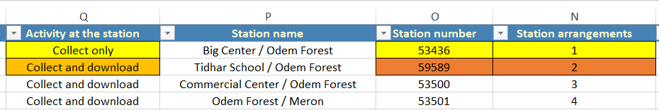
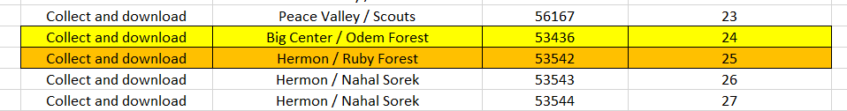
Neighbors
Neighbors Array
0
1
2
. .
1654
1655
53436
 | 59589
|| | 53542
59589
|| | 53500
53542
|| | 53543
53543
|| | 53544

Slide 4
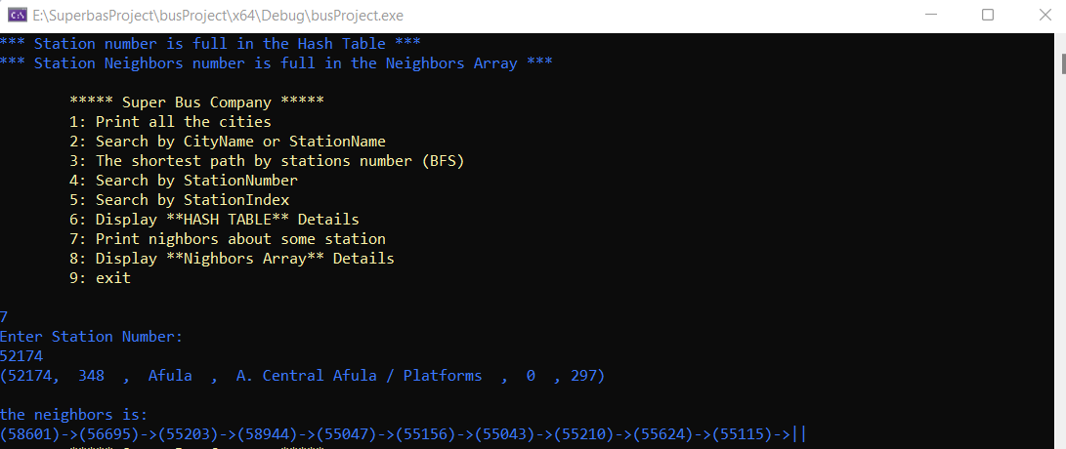
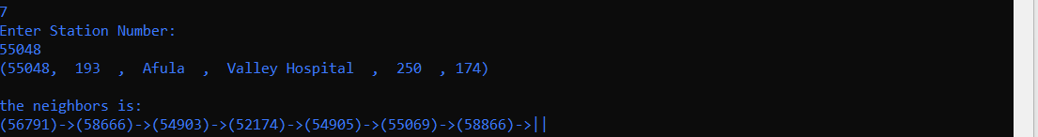
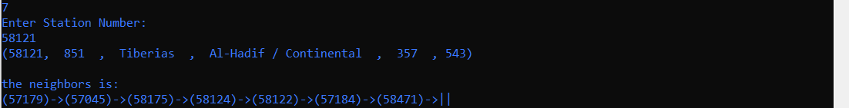
Station neighbors example:

Slide 5
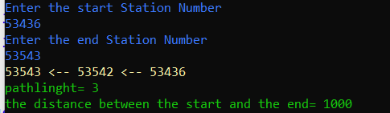
BFS Function
BfsInfo
Start Point
Queue
0
1
2
. .
1654
1655
Visited | Distance | Parent
True | 0 | -1
 |  | 53436
53436
 | 59589 | 53542
59589
Visited | Distance | Parent
True | 0 + 1 | 53436
 | 53543 | 59589
 | 53500 | 53543
Visited | Distance | Parent
True | 0 + 1 | 53436
 |  | 53500
53542
53543
Visited | Distance | Parent
True | 1 + 1 | 53542
.
.
End Point
0+708+292=1000

Slide 6
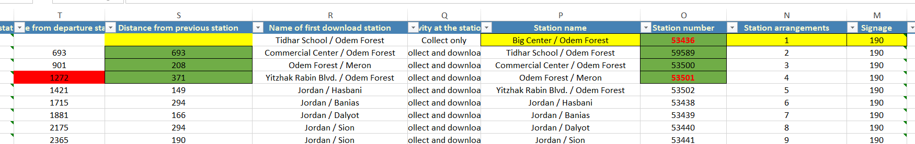
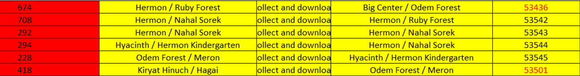
A simple example
Shortest
path
53436
59589
53500
53501
693+
208+
371
Path Length
= 1272
Longest
path
53436
708+
53542
292+
+294
+228
418
53501
53543
53544
53545
Path Length
= 1940

Slide 7
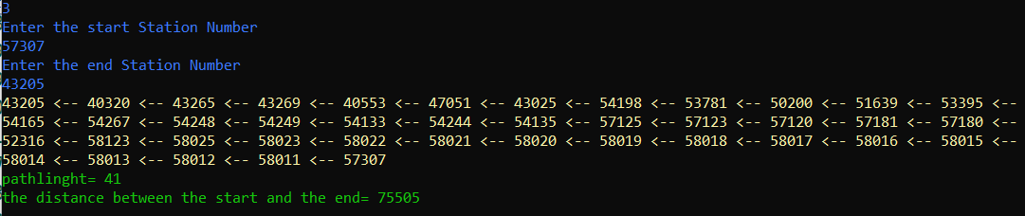
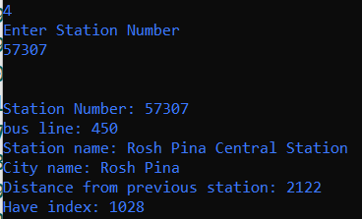
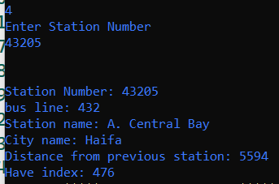
A complex example

Slide 8
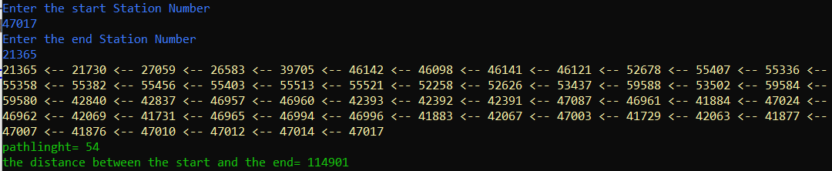
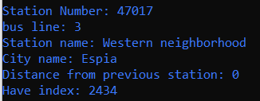
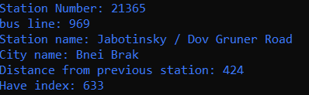
A complex example

Slide 9
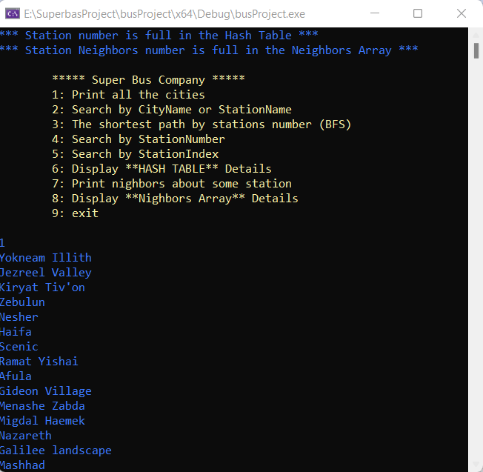
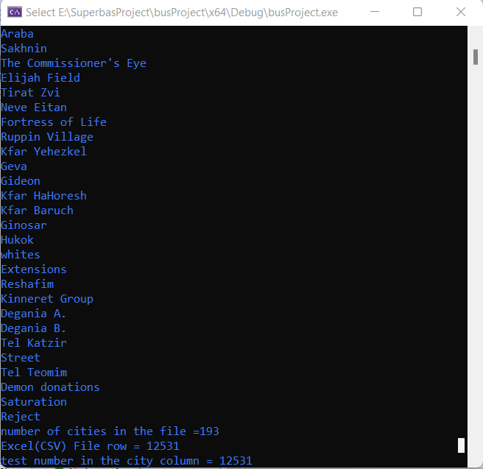
City names:

Slide 10
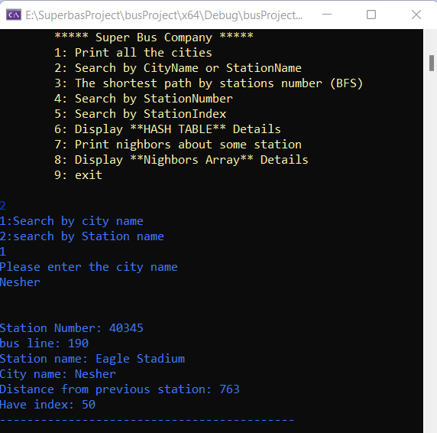
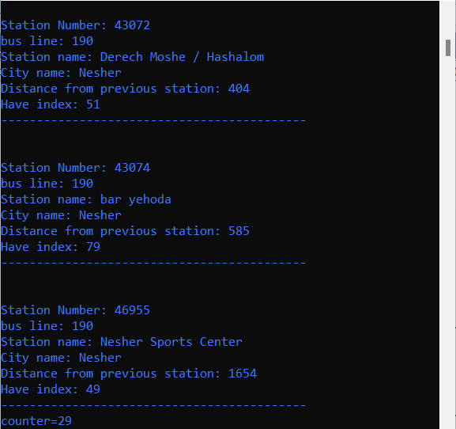
i.e: Stations in Nesher city

Slide 11
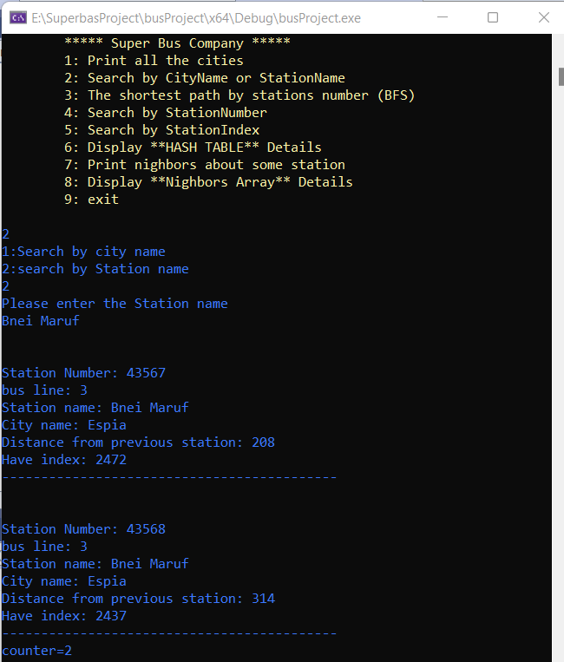
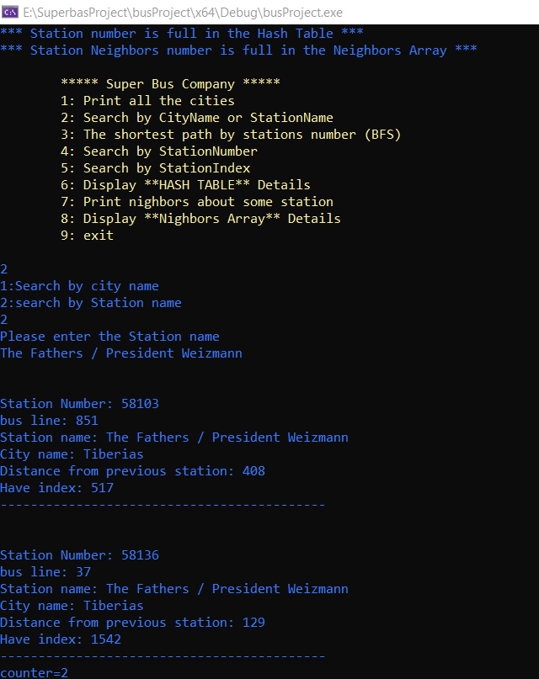
Search by Station name

